Slide 1





Assignment 2 portfolio task 2 - Attack
By:
Krishan Himesh Abeyrathne Tennakoon Mudiyanselage - 12217274
and
Carl YURONG-
12224629
GitHub Repository:
https://github.com/KrishanHimesh/COIT11241-Asignment-2-ePortforlio-Krishan-and-Carl.git

Slide 2
Introduction
Providing organizations with actionable insights to enhance their cybersecurity defenses. By analyzing the group's tactics, techniques, and procedures mapped to the MITRE ATT&CK framework, This report aims to help organizations understand the threat landscape, mitigate risks, prepare for incident response, foster threat intelligence sharing, inform strategic decision-making, and serve as an educational resource for cybersecurity professionals. Ultimately, the report aims to empower organizations to better protect themselves against Medusa Group attacks and contribute to the collective cybersecurity resilience of the broader community.

Slide 3



01
Search the Information System using Nessus , Nmap and Legion for vulnerabilities

Slide 4
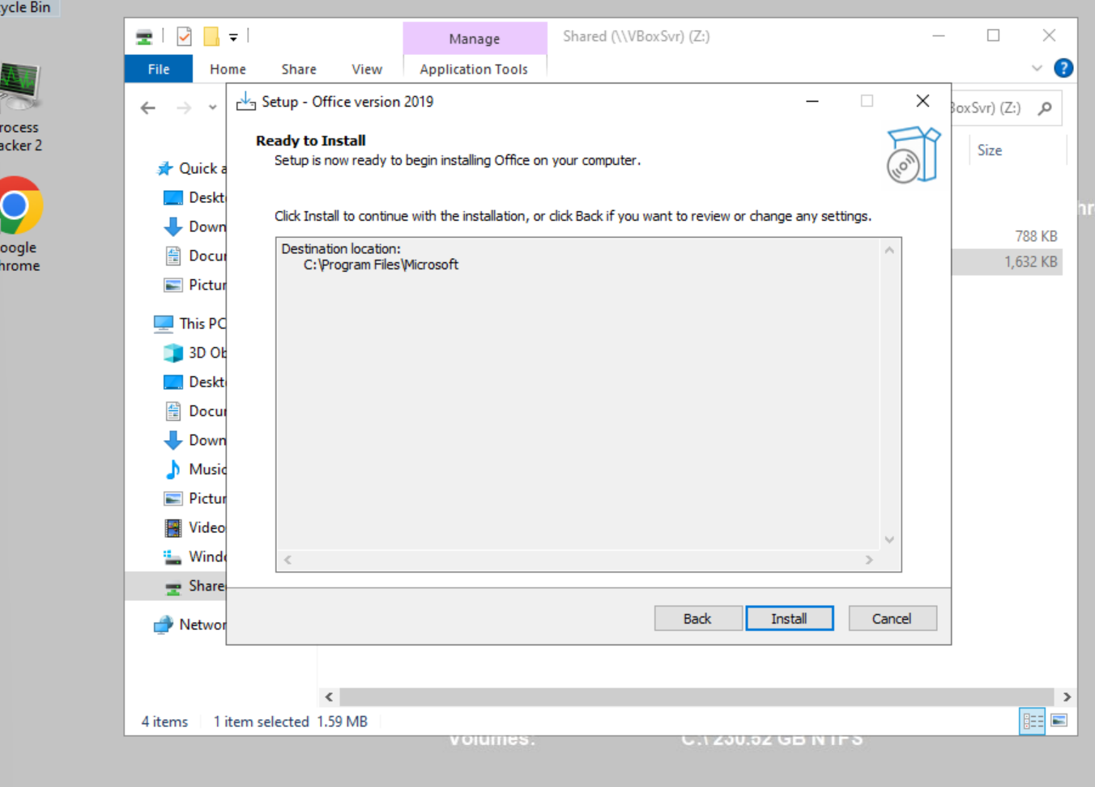
Installation of Software
1. The screenshot shows the installation of 1st Software, installation of MS Office 2019
The screenshot shows the installation of MS Office 2019

Slide 5
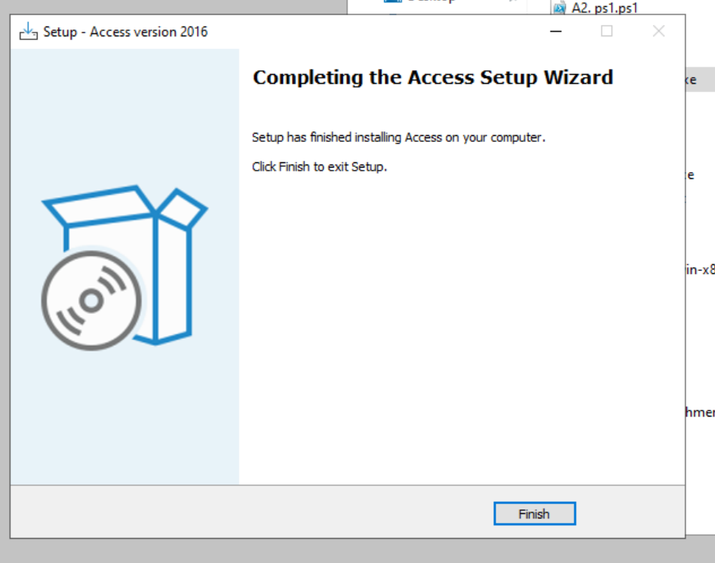
Installation of Software
2. The screenshot shows the installation of 2nd Software, installation of Access Version 2016
The screenshot shows the installation of Access Version 2016

Slide 6
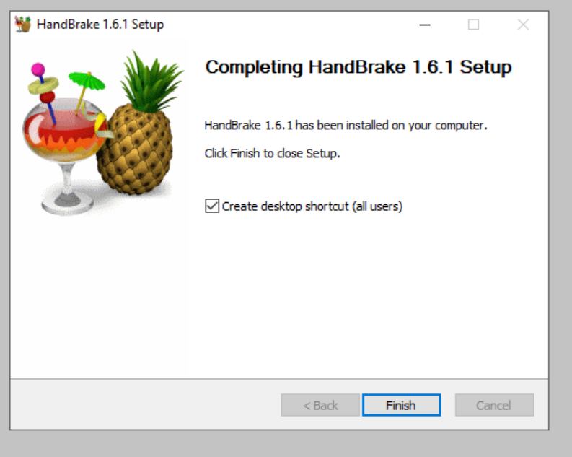
Installation of Software
3. The screenshot shows the installation of 3rd Software, installation of HandBrake-1.6.1
The screenshot shows the installation of HandBrake-1.6.1.

Slide 7
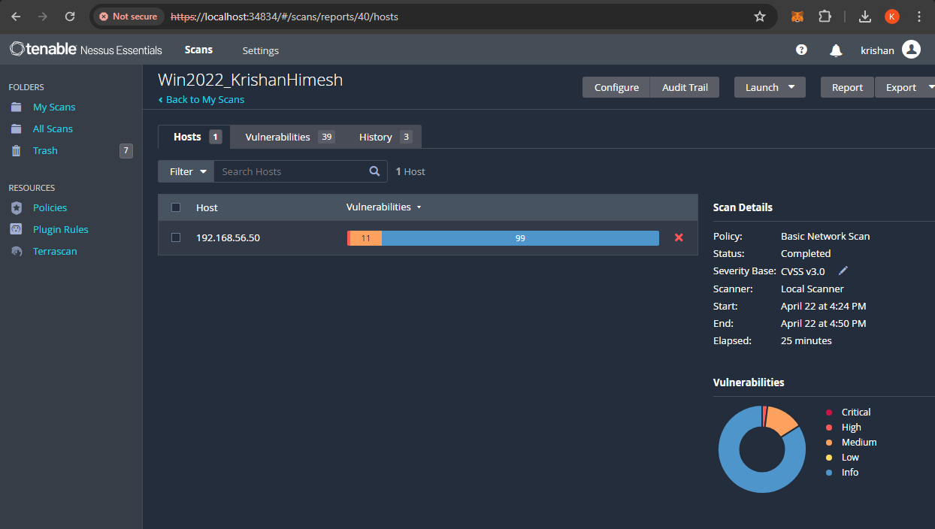
1. Nessus Scan of the Information system for vulnerabilities
The screenshot shows the vulnerability scan result using Nessus of the Information System.
The complete vulnerability test result is shared in the GitHub repository Task 2 -Attack directory. Click this to access the repository

Slide 8
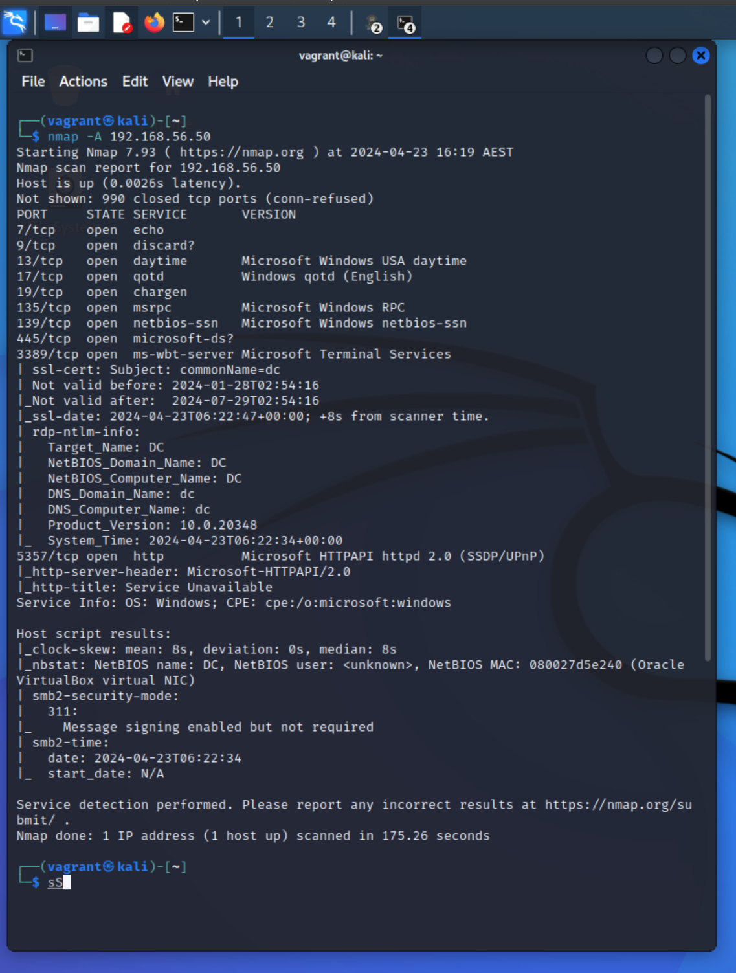
2. Using Nmap to check the Open ports
The screenshot shows the search of Nmap from Kali machine to check the open ports in the Information System, 192.168.56.50.
According to this scan, we can see that port 3389 is open. The Medusa locker targets unsecured RDP servers (HHS 2023). To mitigate this, we can Change the default port used by RDP from 3389 to another.

Slide 9
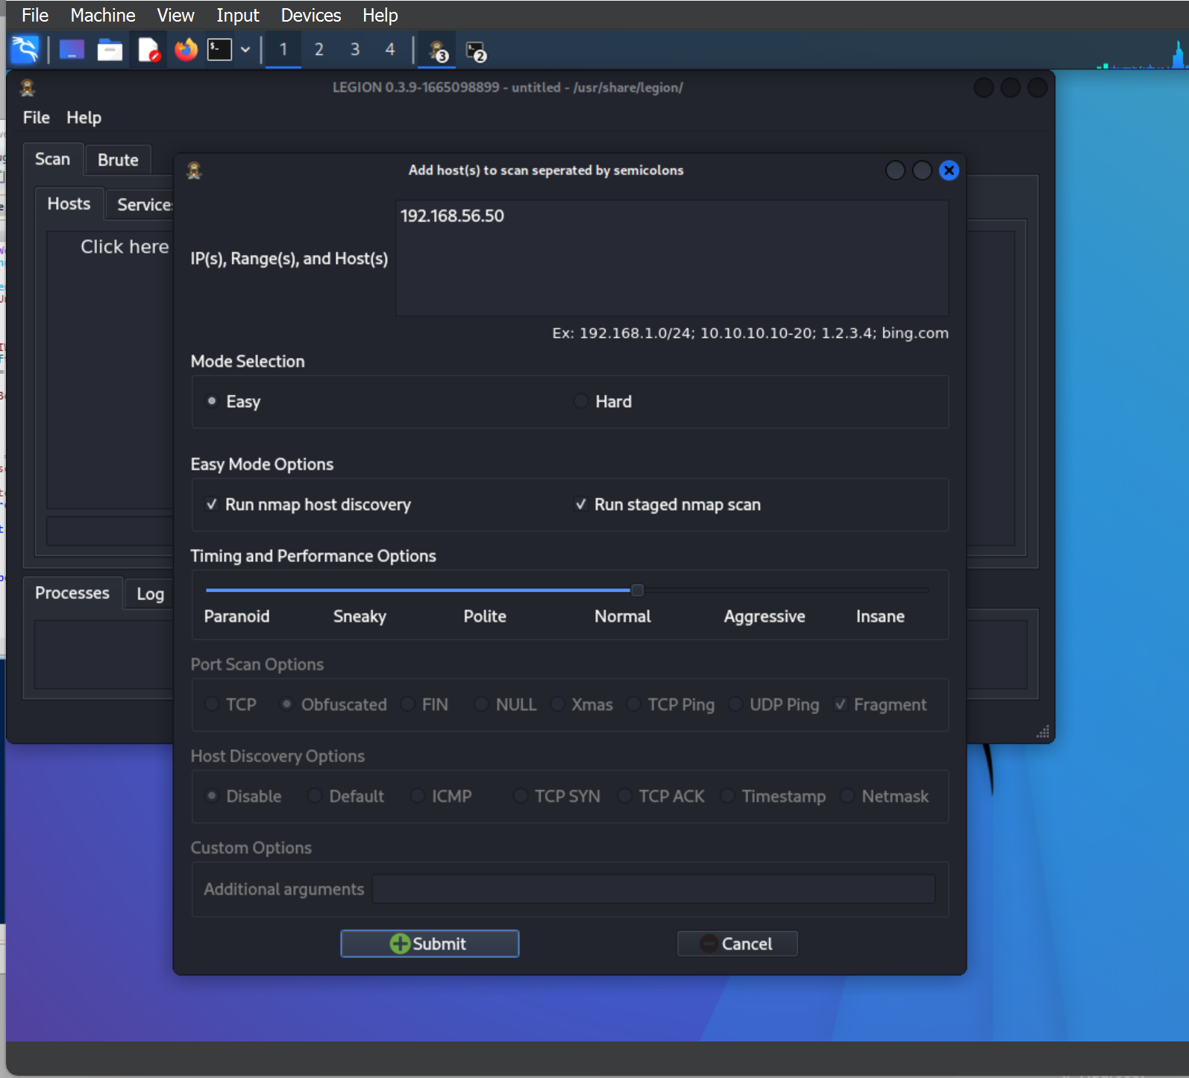
3. Using legion to check vulnerabilities of the information system
The screenshot shows the initiation of the Legion Vulnerability check. We have added the IP address of the information System, 192.168.56.50

Slide 10
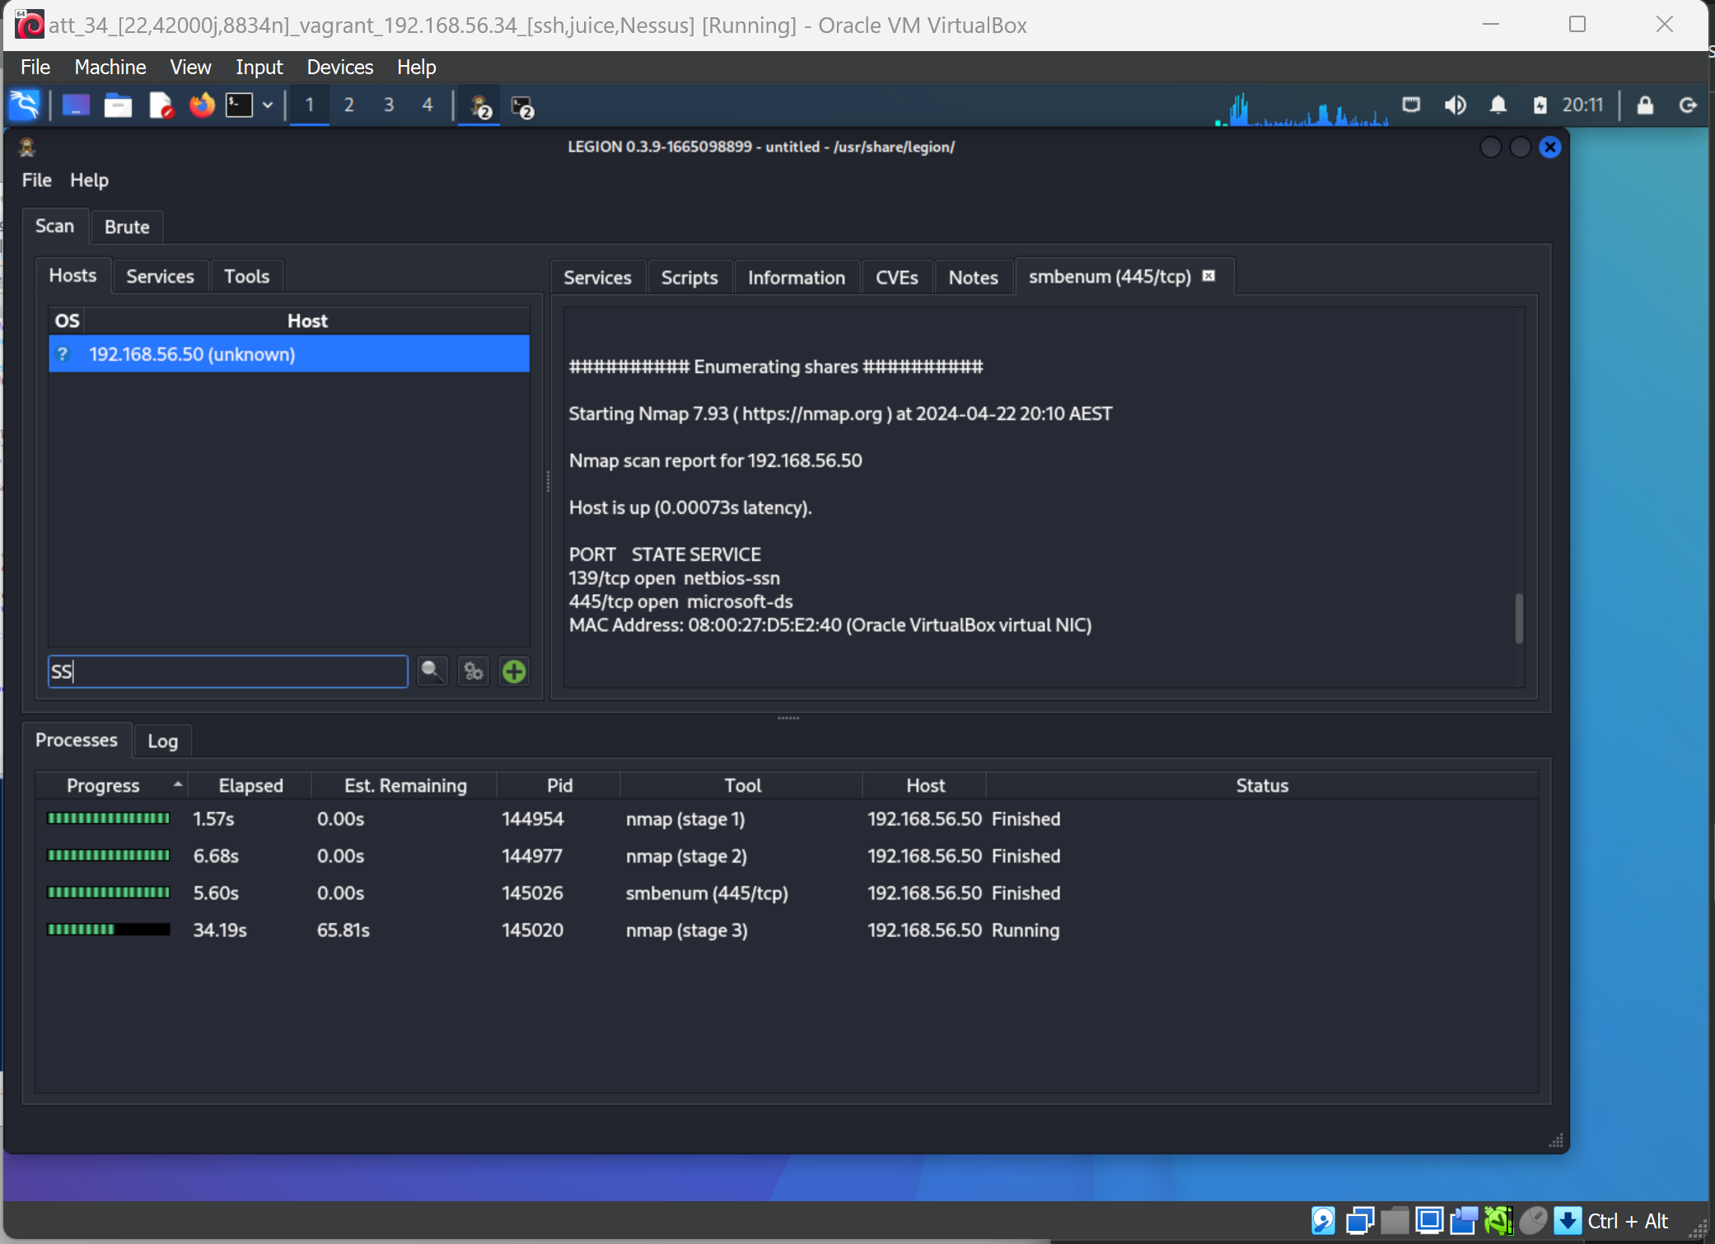
This screenshot shows the scanning of the Information System ( Win2022) using Legion. The IP address of the system is 192.168.56.50

Slide 11
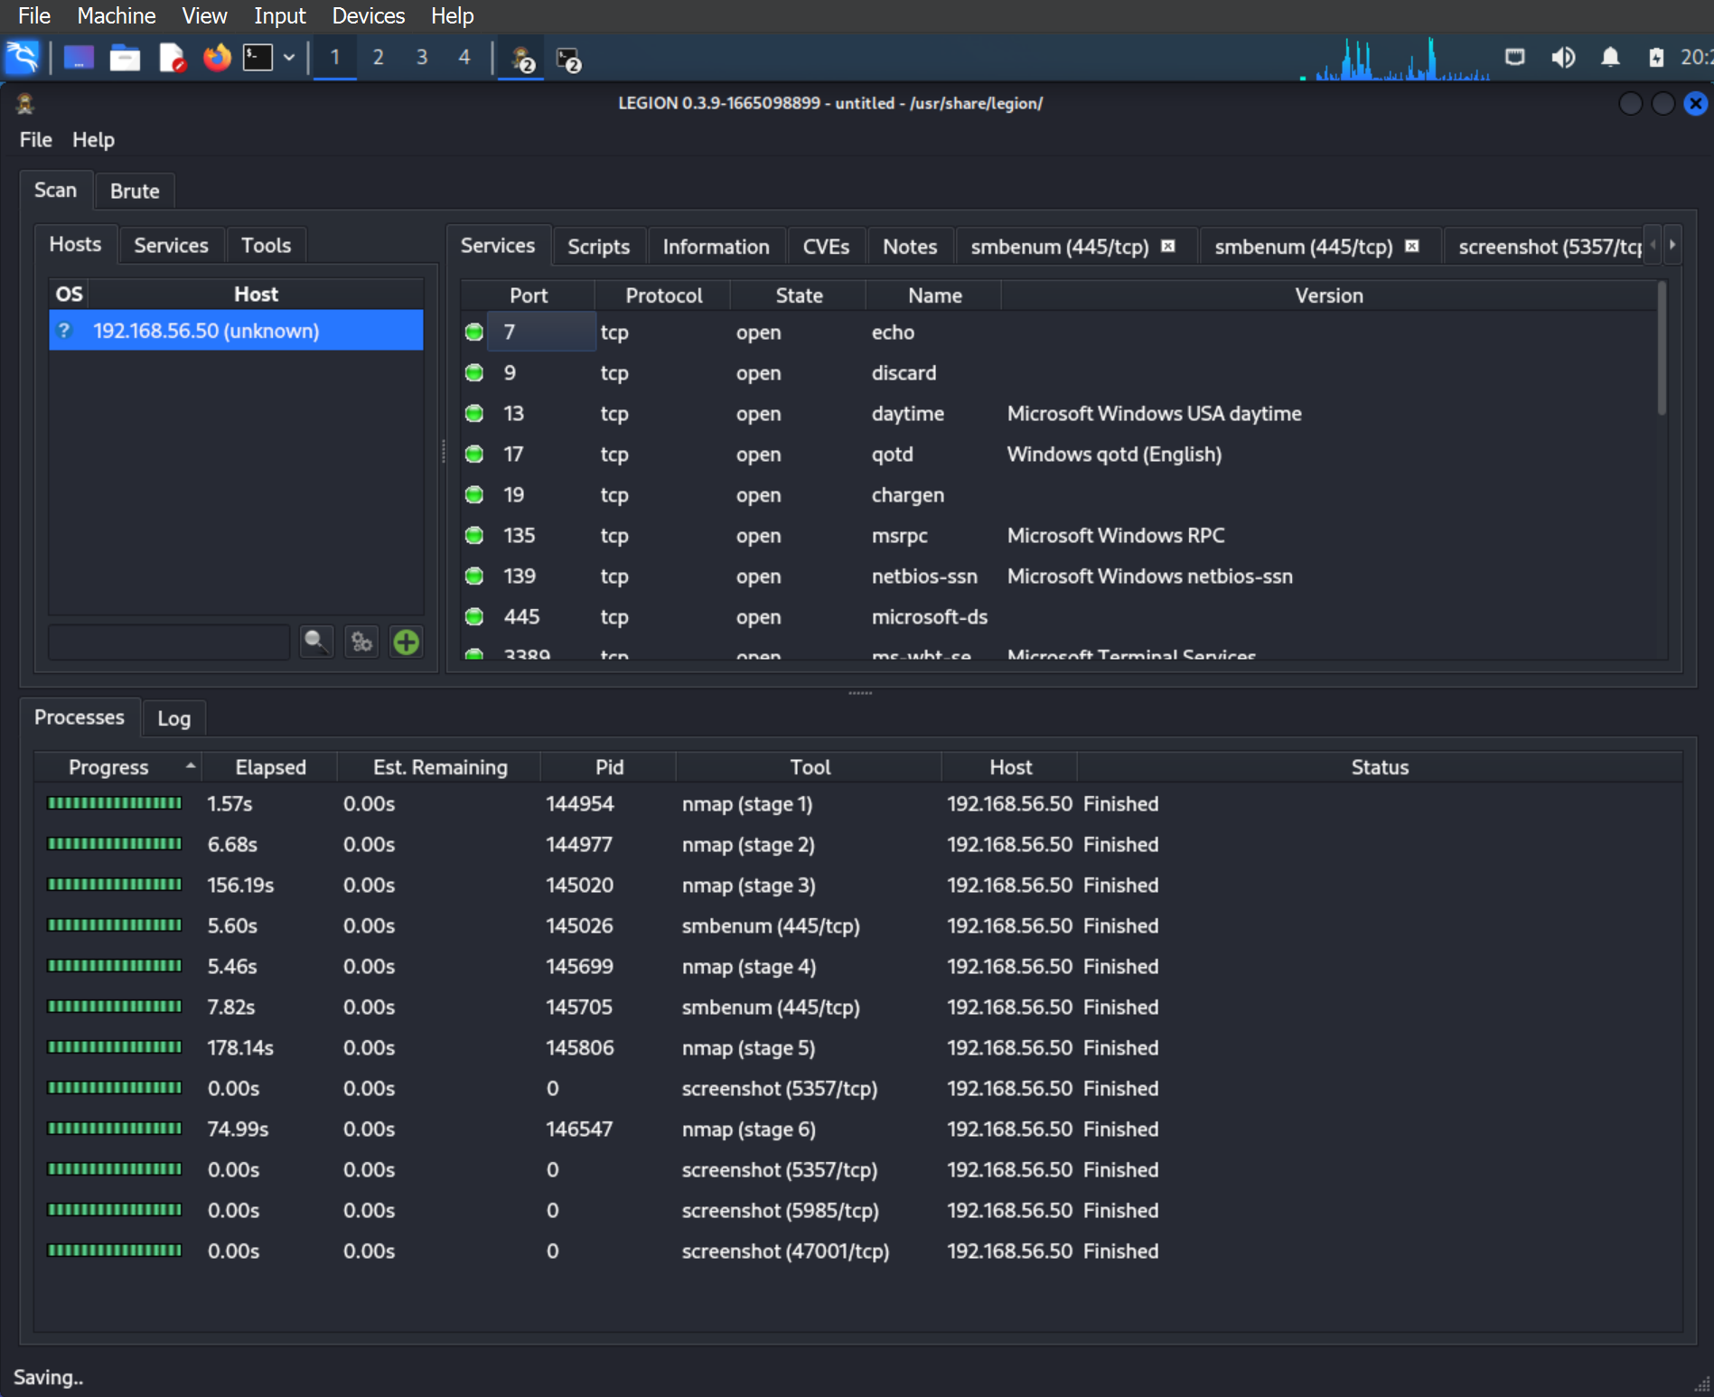
This is the scan result of the Legion. In this, you can see the ports used by the Information System. We can use this to identify the vulnerabilities of the system by open ports to Medusa Locker.
According to this scan, we can see that port 3389 is open. The Medusa locker targets unsecured RDP servers (HHS 2023). To mitigate this, we can Change the default port used by RDP from 3389 to another.

Slide 12
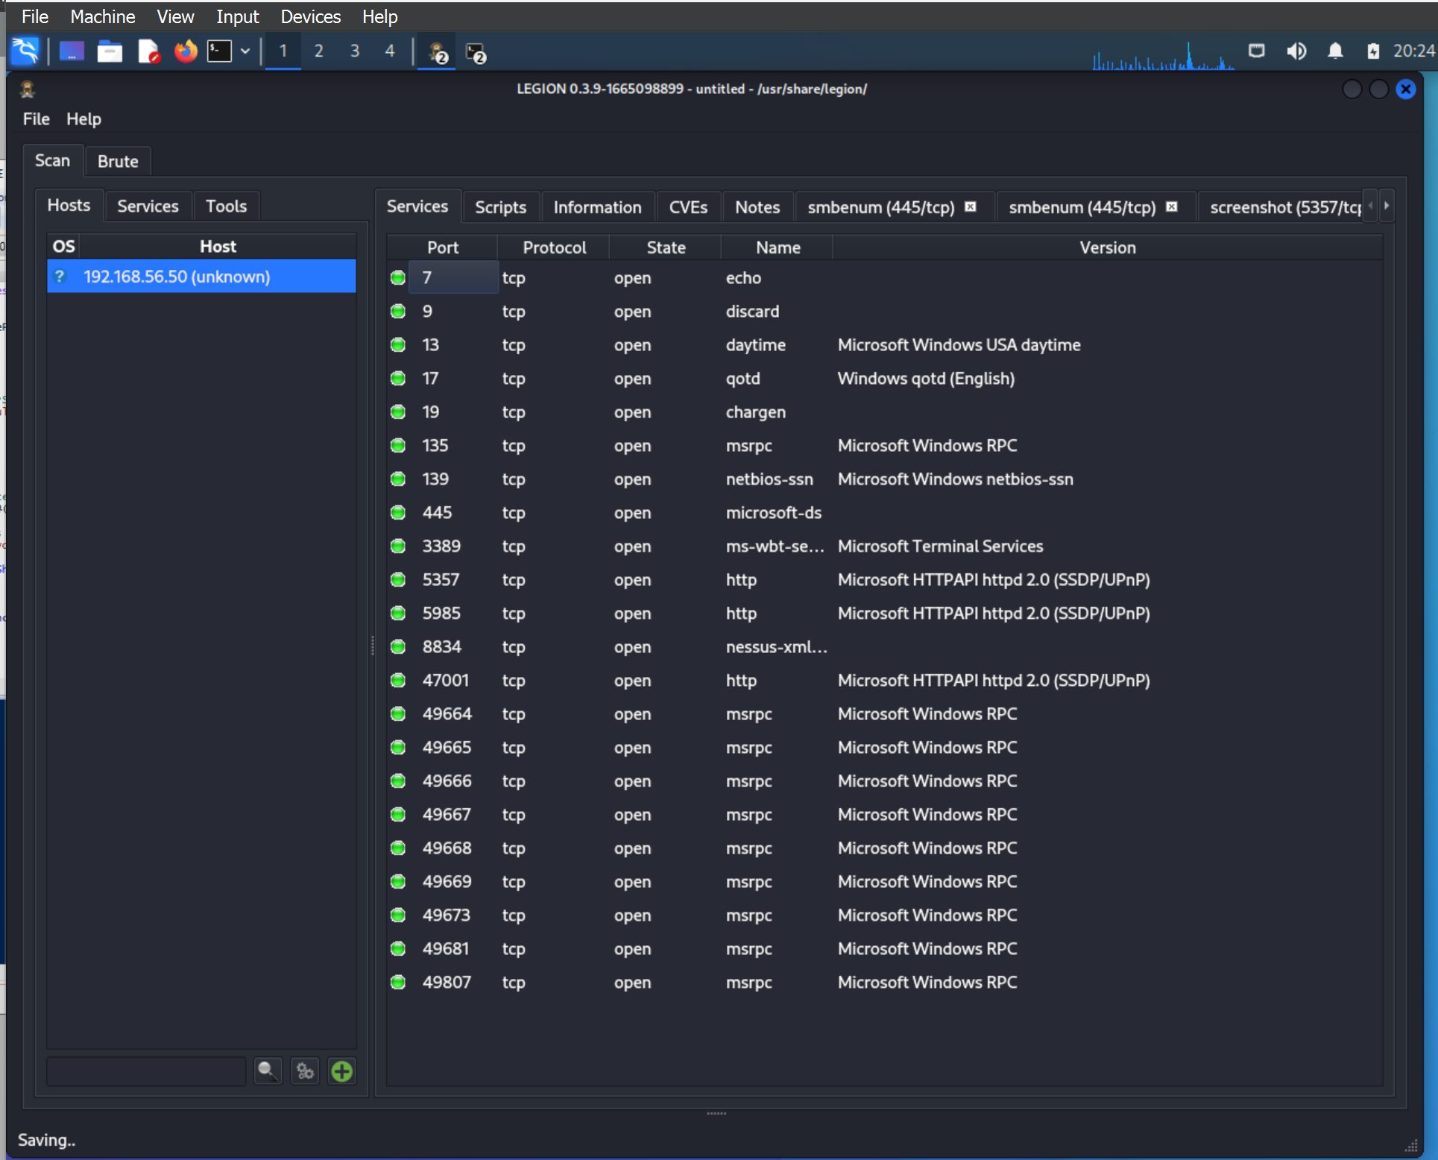
According to this scan, we can see that port 3389 is open. The Medusa locker targets unsecured RDP servers (HHS 2023). To mitigate this, we can Change the default port used by RDP from 3389 to another.

Slide 13
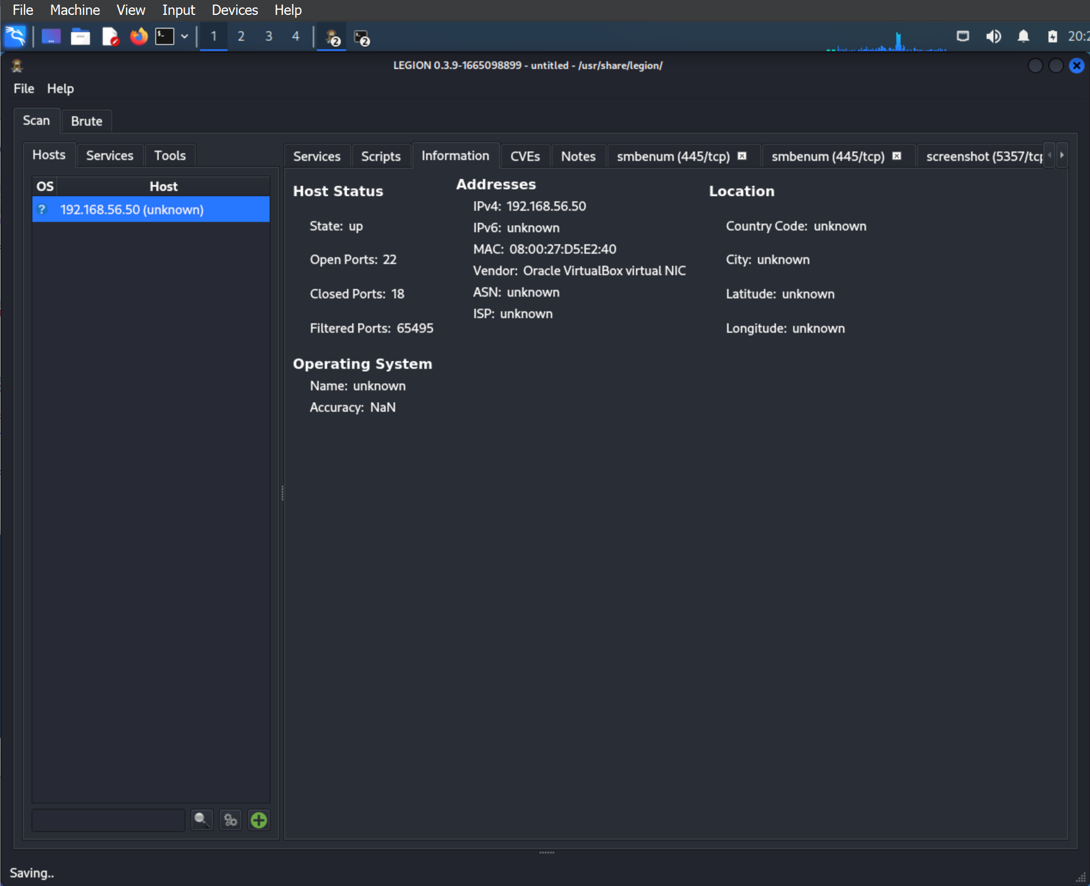
This shows the information about the information system

Slide 14

02
ATT&CK Threat Intelligence Report Medusa Group

Slide 15
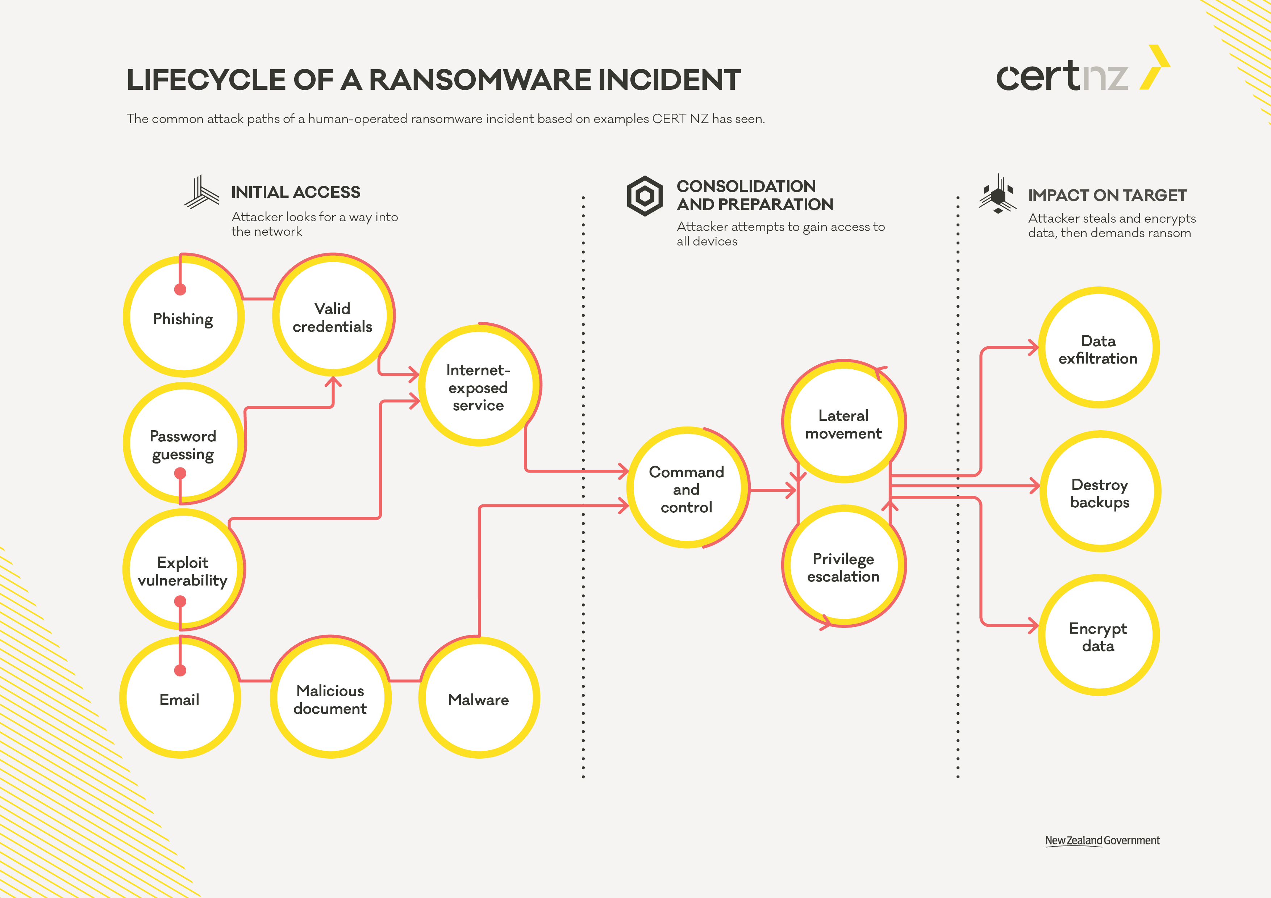
Lifecycle of medusa locker - Ransomware
Image 2.1 Lifecycle of Medusa locker ( CertNZ 2024)

Slide 16
ATT&CK Threat Intelligence Report
Group Name: Medusa Group
Associated Groups: None
Description:
Medusa Group is a cybercrime organization that has been active since at least 2019, primarily focused on deploying the Medusa Locker ransomware across various industries, including healthcare, education, and local government. The group is notorious for encrypting data and demanding ransom payments to provide decryption keys.

Slide 17
Techniques:
Data Encrypted for Impact (T1486) - Medusa Locker encrypts a wide range of file types, using AES and RSA algorithms, to disrupt operations and create urgency for ransom payments.

Slide 18
Rationale of to 5 TTPs
1. Inhibit System Recovery (T1490) - The ransomware stops critical system services and deletes shadow copies to make data recovery without a ransom payment difficult or impossible.
References: MITRE ATT&CK
2. Valid Accounts (T1078) - Medusa Group uses stolen or compromised accounts to gain access to networks, allowing for lateral movement and persistence.
References: CISA Alert AA20-266A

Slide 19
3. Phishing: Spear phishing Attachment (T1566.001) - The group often uses spear phishing emails with malicious attachments to distribute Medusa Locker or steal valid account credentials.
References: MITRE ATT&CK
4. Remote Desktop Protocol (RDP) (T1021.001) - Medusa Group often gains initial access through unsecured RDP or compromised RDP credentials.
References: Microsoft Security Intelligence
5. Boot or Logon Auto start Execution: Registry Run Keys / Startup Folder (T1547.001) – Medusa Locker adds entries to the Windows Registry to ensure execution every time the system restarts, allowing the ransomware to persist on victim systems.
References: MITRE ATT&CK

Slide 20
Description:
Medusa Locker is ransomware used by Medusa Group to encrypt data on victim systems and demand ransom payments. It is known for spreading across networks, stopping critical services, deleting backup data, and ensuring persistence to maximize its impact.
References: CISA Alert AA21-013A
Software Name: Medusa Locker

Slide 21
Service Stop (T1489) - Medusa Locker stops Windows services related to backups, anti-virus, and system recovery, preventing mitigation and ensuring a successful attack.
References: MITRE ATT&CK
Rationale for Sub/Techniques Selection:
The chosen techniques reflect the critical components of Medusa Group's modus operandi. Each technique plays a crucial role in the attack lifecycle, from gaining initial access and establishing persistence to executing the ransomware and inhibiting recovery efforts. The use of spear phishing, RDP, and valid accounts provides multiple entry points, while service stops and boot AutoStart ensure Medusa Locker operates without interference. These combined techniques maximize the impact of the ransomware attack, leading to successful ransom payments and significant financial gains for the group.

Slide 22

03 Priorities of vulnerabilities found based on their likelihood of exploitation by the Threat Actor

Slide 23
Purpose
One of the essential ways for an effective risk management and proactive defense in cybersecurity. By focusing on vulnerabilities with a higher likelihood of exploitation, organizations can optimize resource allocation, enhance incident response preparedness, and comply with regulatory requirements more effectively. This approach enables organizations to mitigate critical risks promptly, reduce overall exposure to cyber threats, and improve their overall security posture.

Slide 24
CVE 1: CVE-2016-2183
SSL Medium Strength Cipher Suites Supported (SWEET32) RISK FACTOR: Medium
CWE | CAPEC | ATT&CK | Used by Medusa
CWE-326 - Inadequate Encryption Strength | CAPEC-152 - Cryptanalysis | T1555: Credential from Password Stores | Yes, SWEET32 allows man-in-the middle attacks
 |  | T1557: Adversary-in-the-Middle | Yes, exploiting weak ASL ciphers
 |  | T1560: Archive Collected Data | Not in ATT&CK

Slide 25
Description: The remote host supports the use of SSL ciphers that offer medium-strength encryption. Nessus regards medium strength as any encryption that uses key lengths at least 64 bits and less than 112 bits, or else that uses the 3DES encryption suite. Note that it is considerably easier to circumvent medium-strength encryption if the attacker is on the same physical network. Solution: Reconfigure the affected application if possible to avoid use of medium-strength ciphers.

Slide 26
CVE 2: 2021-31166 10061 - Echo Service Detection Risk factor: Medium
CWE | CAPEC | ATT&CK | Used by Medusa
758 | 118 Flooding | T1498: Network Denial of Service | Yes, Echo service can lead to DoS attacks
 |  | T1046: Network Sniffing Not in ATT&CK | Not in ATT&CK
 |  | T1071: Application Layer Protocol | Not in ATT&CK

Slide 27
Description: An echo service is running on the remote host. The remote host is running the 'echo' service. This service echoes any data which is sent to it. This service is unused these days, so it is strongly advised that you disable it, as it may be used by attackers to set up denial of services attacks against this host
Solution: Below are some examples of how to disable the echo service on some common platforms, however many services can exhibit this behavior and the list below is not exhaustive. Consult vendor documentation for the service exhibiting the echo behavior for more information. - Under Unix systems, comment out the 'echo' line in /etc/inetd.conf and restart the inetd process. - Under Ubuntu systems, comment out the 'echo' line in /etc/systemd/system.conf and retart the systemd service. - Under Windows systems, set the following registry key to 0 : HKLM\System\CurrentControlSet\Services\SimpTCP\Parameters\EnableTcpEcho HKLM\System \CurrentControlSet\Services\SimpTCP\Parameters\EnableUdpEcho Then launch cmd.exe and type : net stop simptcp net start simptcp to restart the service

Slide 28
CVE 3: CVE-2001-1000 Quote of the Day - QOTD Service Detection Risk factor: MEDIUM
CWE | CAPEC | ATT&CK | Used by Medusa
319 | 250 Reflection Attack | T1498: Network Denial of Service | Yes, QOTD service can be used for DoS attacks
 |  | T1046: Network Sniffing | Not in ATT&CK
 |  | T1071.001: Application Layer Protocol | Not in ATT&CK

Slide 29
Description: The quote service (qotd) is running on this host. A server listens for TCP connections on TCP port 17. Once a connection is established a short message is sent out the connection (and any data received is thrown away). The service closes the connection after sending the quote. Another quote of the day service is defined as a datagram based application on UDP. A server listens for UDP datagrams on UDP port 17. When a datagram is received, an answering datagram is sent containing a quote (the data in the received datagram is ignored). An easy attack is 'pingpong' which IP spoofs a packet between two machines running qotd. This will cause them to spew characters at each other, slowing the machines down and saturating the network. Solution:
- Under Unix systems, comment out the 'qotd' line in /etc/inetd.conf and restart the inetd process - Under Windows systems, set the following registry keys to 0 : HKLM\System\CurrentControlSet\Services\SimpTCP\Parameters\EnableTcpQotd HKLM\System \CurrentControlSet\Services\SimpTCP\Parameters\EnableUdpQotd Then launch cmd.exe and type : net stop simptcp net start simptcp to restart the service.

Slide 30
04
Three Attacks Emulation

Slide 31
Attack 01 - Emulation of Medusa Locker Attack Encryption

Slide 32
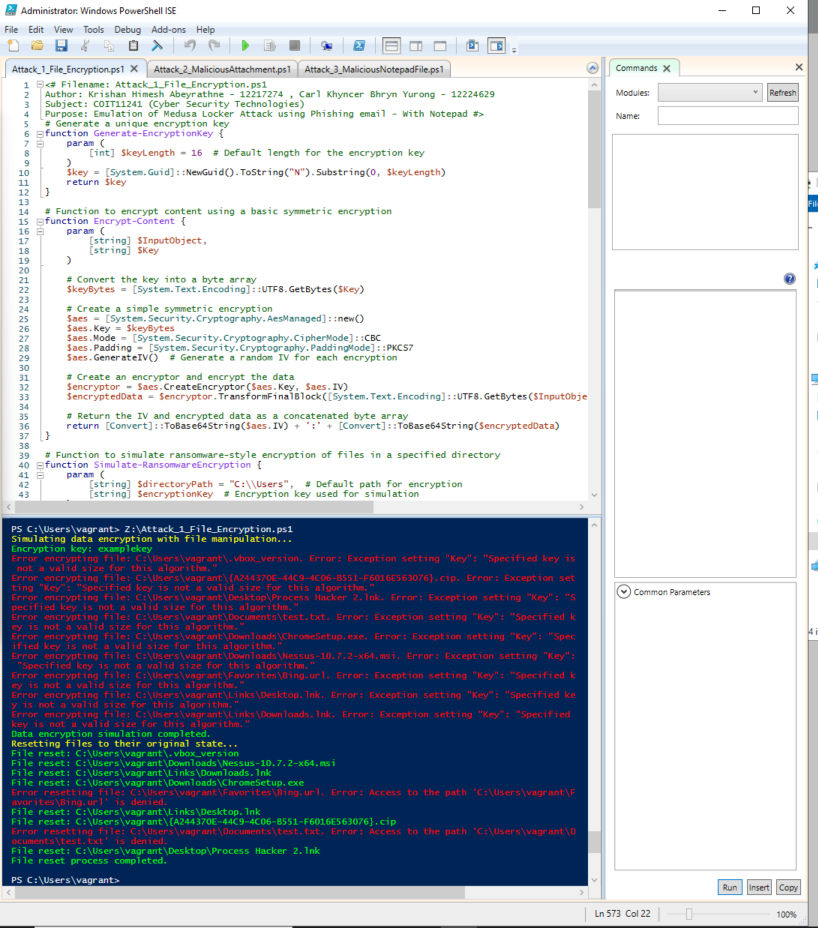
1. Emulation of Medusa Locker Attack Encryption
The screenshot shows the PowerShell script and the result of the code after executing. The next Slide shows the result after running the Scrip. To access the PS script file, please check the GitHub Repository
The code is fully automated.
If you want to simulate separately, please run the functions separately.
According to the assignment specifications, we can use AI tools to generate scripts. This code was created with the help of ChatGPT 3.5 and modified the code by ourselves to fit the requirements.

Slide 33
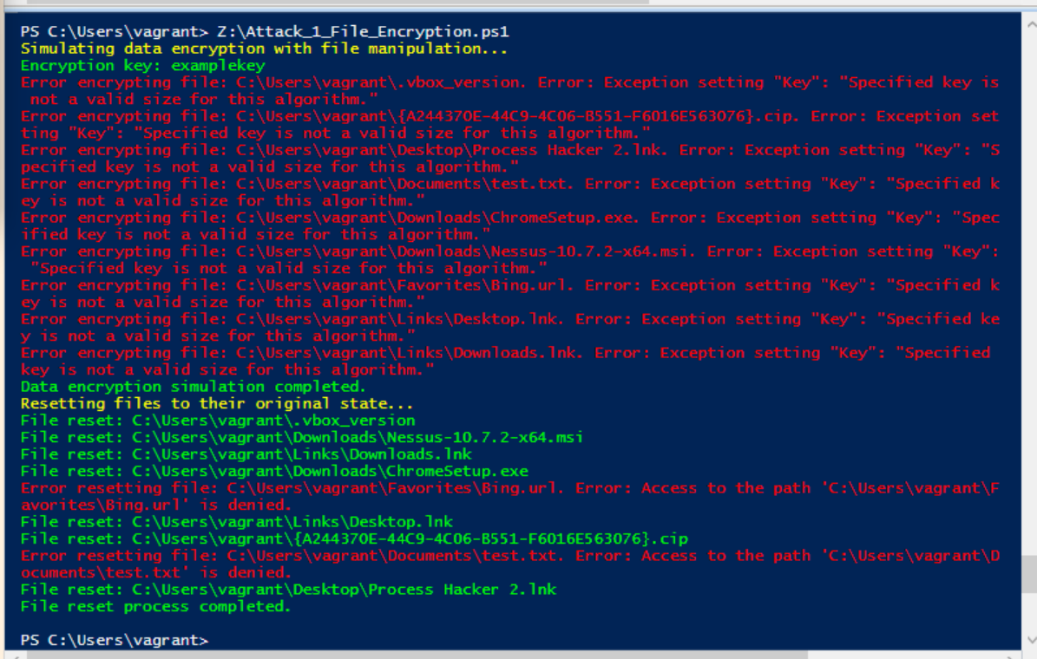
Emulation of Medusa Locker Attack using Encryption attack
The 'Attack_1_file_Encryption' PowerShell script simulates a ransomware-style attack by encrypting files in each directory and then resetting them to their original state. The script emulates certain behaviours typical of ransomware attacks, like those exhibited by Medusa Locker malware, but without causing actual harm. This educational script demonstrates how ransomware might operate by encrypting files, mimicking the techniques involved, and then safely restoring them to their original condition. It aligns with several MITRE ATT&CK techniques, including T1486 for data encryption, T1547.001 for registry persistence, and T1059.001 for PowerShell command execution. Despite its ransomware-like behaviour, it doesn't execute any malicious code, making it a valuable tool for learning and testing in a controlled environment.

Slide 34
Here's a breakdown of the script's components:
Generate-EncryptionKey Function:
This function creates a unique encryption key for symmetric encryption. It uses a GUID (Globally Unique Identifier) to generate a 16-character key.
Encrypt-Content Function:
This function encrypts a given text input using a basic symmetric encryption technique. It uses the AES (Advanced Encryption Standard) algorithm with CBC (Cipher Block Chaining) mode and PKCS7 padding. An Initialization Vector (IV) is generated to add randomness, ensuring that encryption of identical text yields different results.
Simulate-RansomwareEncryption Function:
This function simulates a ransomware encryption attack on all files within a specified directory (in this case, "C:\\Users"). It encrypts the content of each file and replaces the original content with the encrypted data. The function maintains a backup of the original content in a hash table to restore the files later. If an error occurs during encryption, it logs the issue.

Slide 35
Reset-Files Function:
This function resets the files to their original state using the backups stored earlier. It writes the original content back to each file.
If an error occurs during reset, it logs the issue.
The script simulates a ransomware-style encryption process on the specified directory using a given encryption key ("examplekey").
After simulating the encryption, it resets the files to their original state using the stored backups.
Overall, this script is designed to mimic ransomware behavior, encrypting files and then resetting them, which can be used for educational or testing purposes. However, this is for simulation only, and it should not be used on critical systems or data without proper backups and precautions.

Slide 36
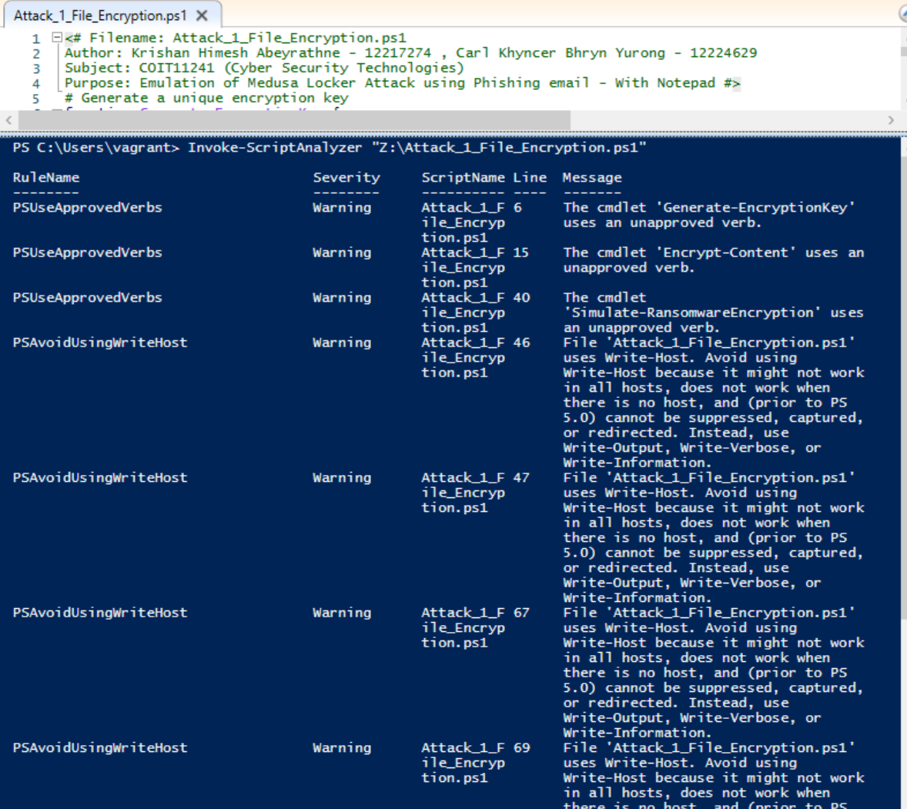
Analise script-1 using the script analyzer and clean the script - Before

Slide 37
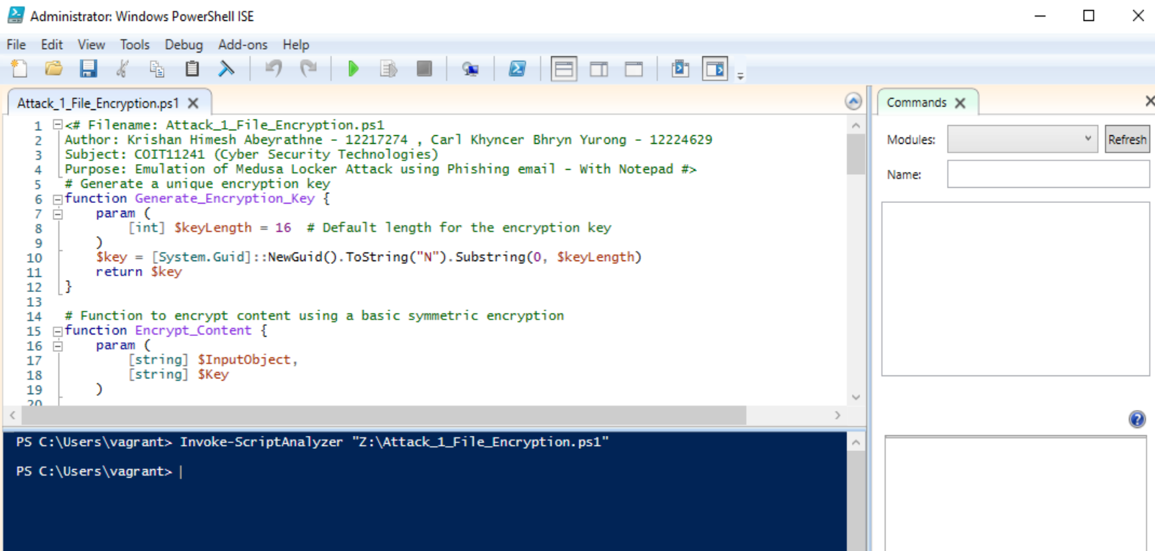
Analise script-1 using the script analyzer and clean the script - After
This Screenshot shows after cleaning the script using Script Analyzer. There are no warnings after invoke the script analyzer.

Slide 38
Attack 02 - Emulation of Medusa Locker Attack using Phishing email- Using EXE file

Slide 39
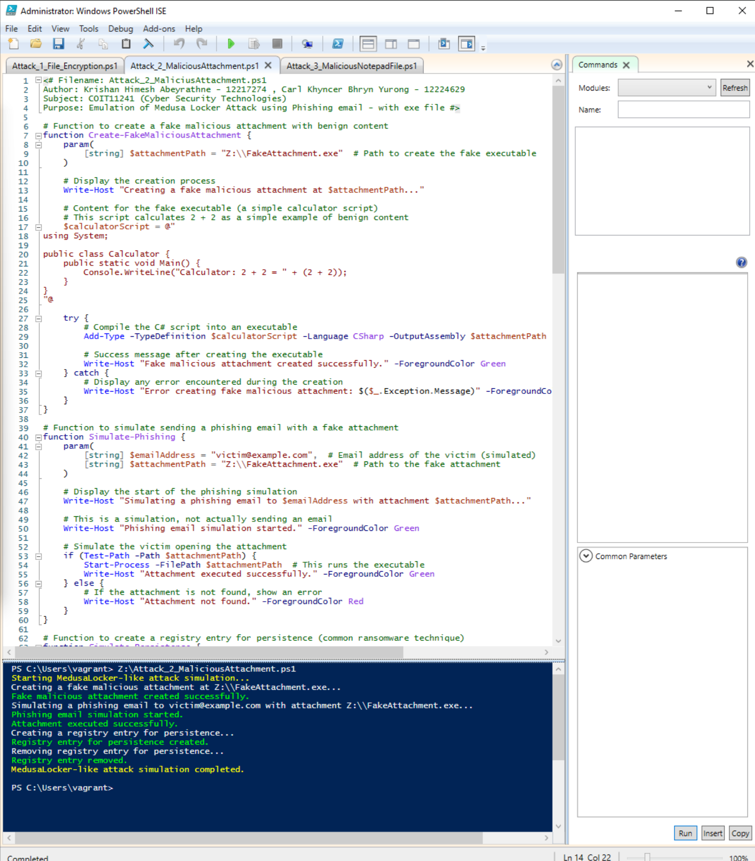
2. Emulation of Medusa Locker Attack using Phishing email- Using EXE file
The screenshot shows the PowerShell script and the result of the code after executing. The next Slide shows the result after running the Scrip. To access the PS script file, please check the GitHub Repository
The code is fully automated.
If you want to simulate separately, please run the functions separately.
According to the assignment specifications, we can use AI tools to generate scripts. This code was created with the help of ChatGPT 3.5 and modified the code by ourselves to fit the requirements.

Slide 40
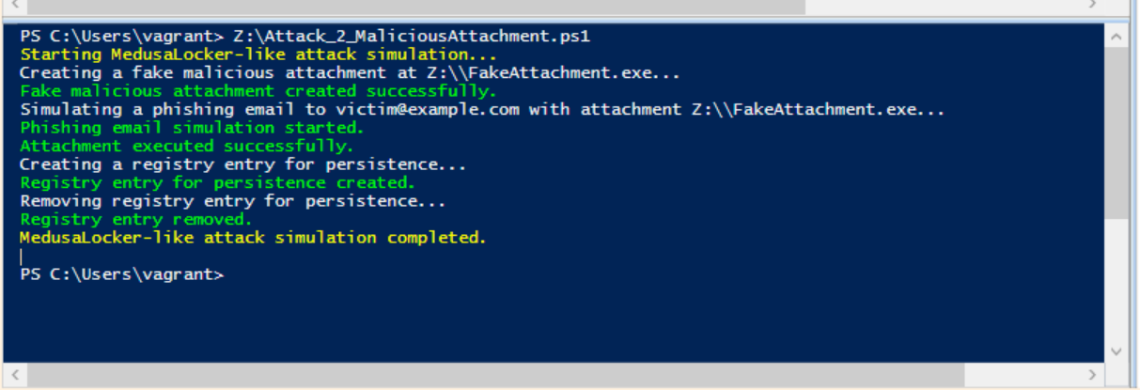
Emulation of Medusa Locker Attack using Phishing email
The "Attack_2_MaliciousAttachment" script demonstrates a simulated Medusa Locker-like ransomware attack using a fake malicious executable attachment. It reflects techniques frequently observed in real ransomware attacks. The script illustrates three key steps in typical ransomware scenarios: creating a malicious executable, sending a phishing email with the attachment, and creating a registry entry for persistence.
These steps align with specific MITRE ATT&CK tactics and techniques. Creating malicious executables corresponds to T1059: Command and Scripting Interpreter, while phishing emails with malicious attachments align with T1566: Phishing. Registry-based persistence is consistent with T1547.001: Registry Run Keys / Startup Folder. The script emulates these techniques for educational purposes, emphasising how ransomware attacks typically operate.

Slide 41
Here's a detailed explanation of what each part of the script does:
Functions and Operations
Create-FakeMaliciousAttachment Function:
This function creates a fake executable file (FakeAttachment.exe) with benign content to simulate a malicious attachment. The content is a simple calculator script that calculates 2 + 2. It compiles this script into an executable using C#.
Simulate-Phishing Function:
This function simulates sending a phishing email with the fake attachment created in the previous step. It doesn't actually send an email but mimics the process of a victim opening the attachment. If the attachment exists, the script executes it, simulating what happens when a victim opens a malicious attachment. It uses the Start-Process command to run the executable.
If the attachment doesn't exist, it logs an error message.
Simulate-Persistence Function:
This function creates a registry entry to simulate persistence, a technique used by ransomware to ensure that it runs each time the system starts.
It creates a registry entry in the "HKCU:\\Software\\Microsoft\\Windows\\CurrentVersion\\Run" key with a specified name ("FakeRansomware") and sets the value to point to the fake executable. If an error occurs, it logs an error message.

Slide 42
Cleanup-Persistence Function:
This function cleans up the registry entry created in the previous step to leave no traces after the simulation.
It removes the registry entry with the specified name, ensuring the fake executable does not persist after the script ends.
If an error occurs during removal, it logs an error message.
Main Script Execution
The script starts by creating a fake malicious attachment, simulating a phishing email, and then simulating persistence through a registry entry.
It then cleans up by removing the registry entry to prevent the lingering effects of the simulation.
The final output indicates that the Medusa Locker-like attack simulation is completed.
Use Cases
This script can be used to demonstrate common ransomware techniques. It can be employed in simulations to showcase how ransomware attacks occur and how they can persist on a system.
Important: This script should only be used in safe environments with proper precautions.

Slide 43
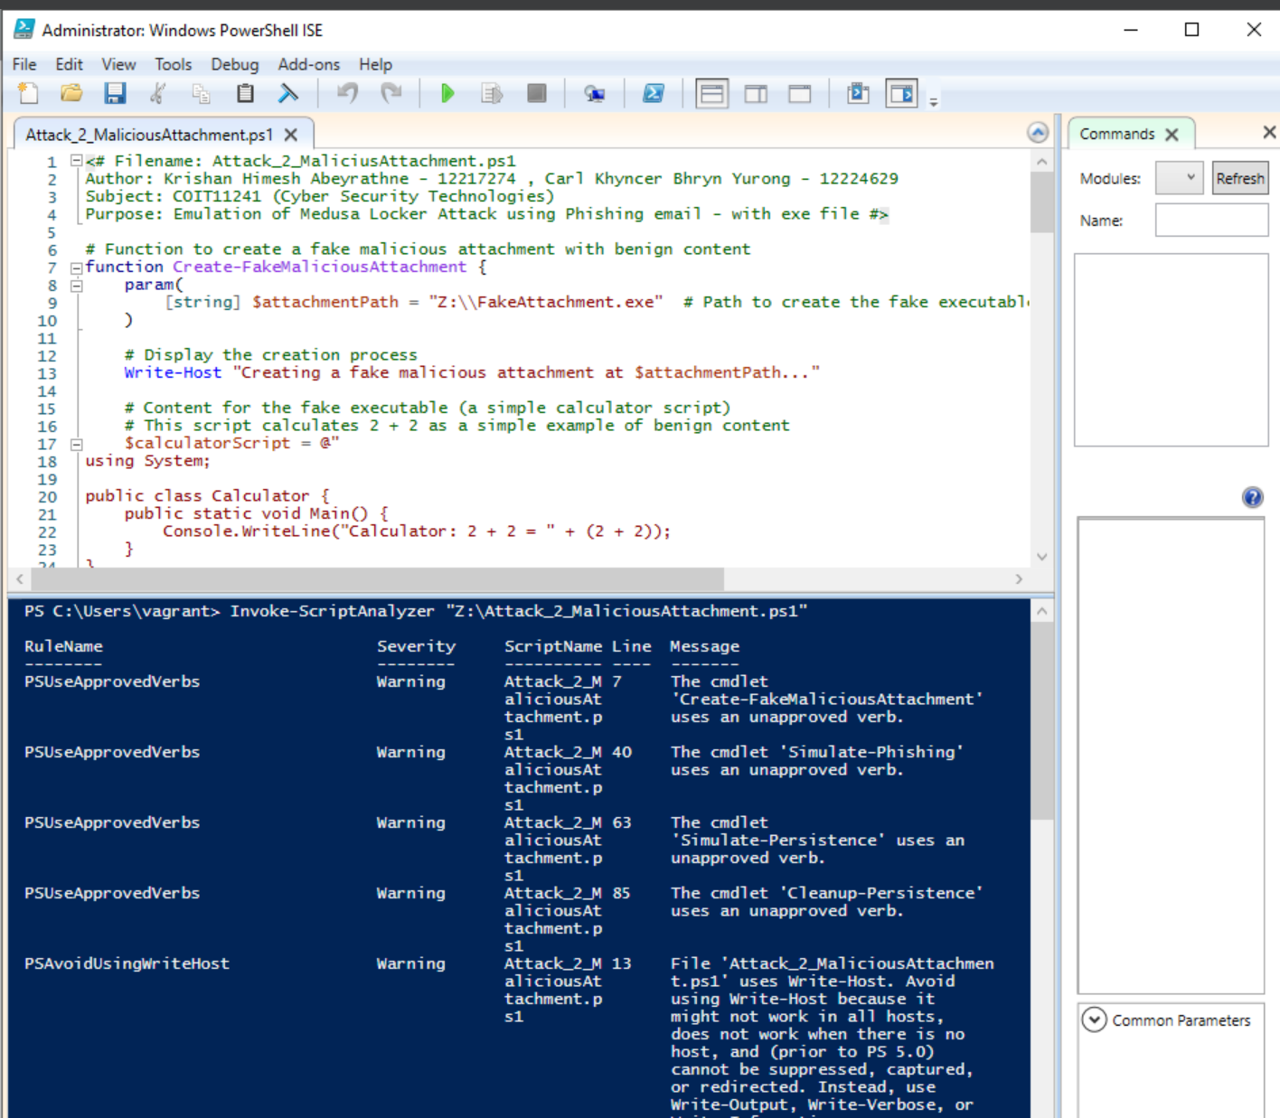
Analyze the script-2 using the script analyzer and clean the script - Before

Slide 44
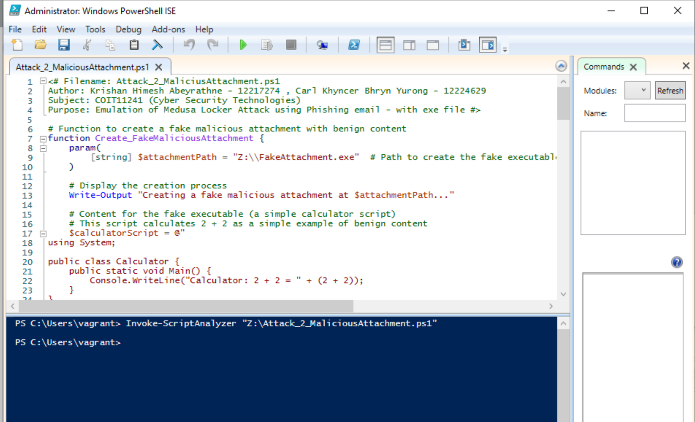
Analyze the script-2 using the script analyzer and clean the script - After
This Screenshot shows after cleaning the script using Script Analyzer. There are no warnings after invoking the script analyzer.

Slide 45
Attack 03 - Emulation of Medusa Locker Attack using Phishing email – Notepad file

Slide 46
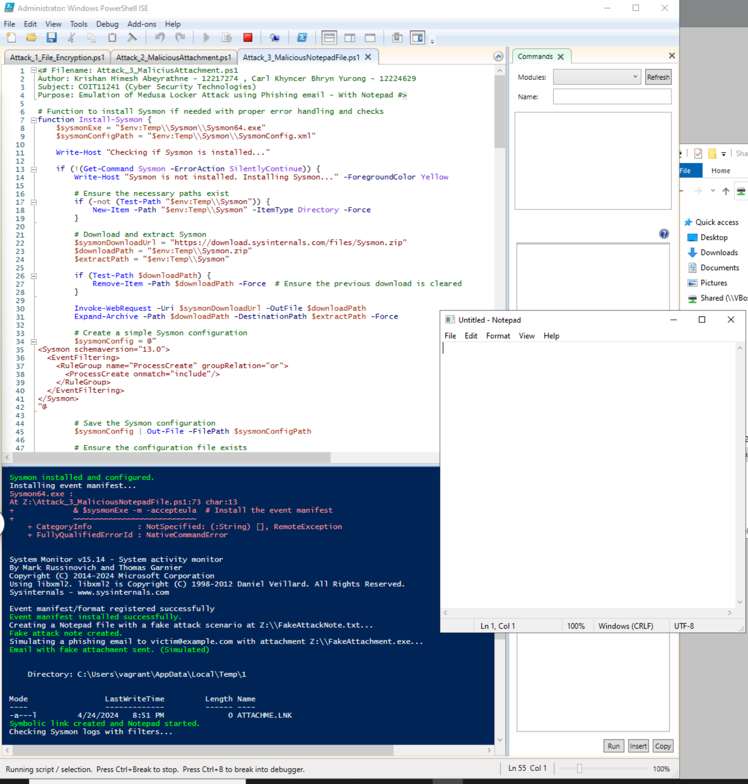
3. Emulation of Medusa Locker Attack using Phishing email – Notepad file
Please note this 3rd attack is an additional one. The assignment required only 2.
The screenshot shows the PowerShell script and the result of the code after executing. The next Slide shows the result after running the Scrip. To access the PS script file, please check the GitHub Repository
The code is fully automated.
If you want to simulate separately, please run the functions separately.
According to the assignment specifications, we can use AI tools to generate scripts. This code was created with the help of ChatGPT 3.5 and modified the code by ourselves to fit the requirements.

Slide 47
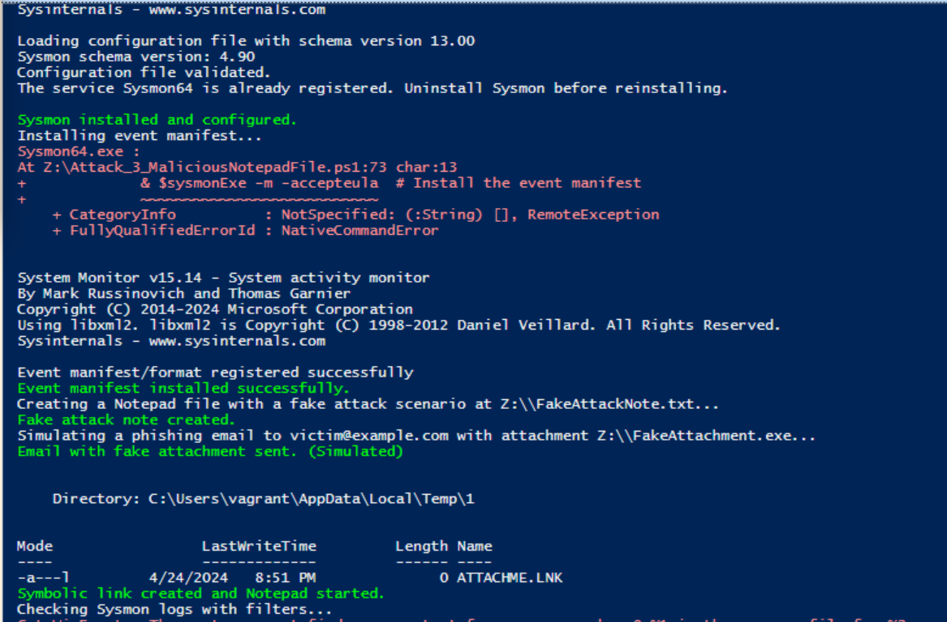
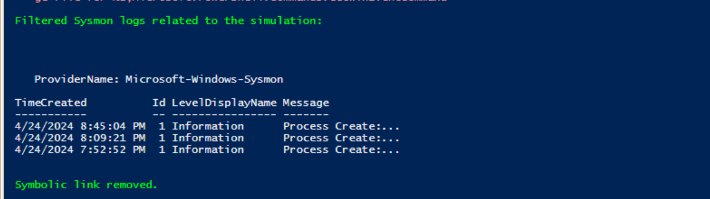
Emulation of Medusa Locker Attack using Phishing email
The "Attack_3_MaliciousNotepadFile" script demonstrates a simulation of a Medusa Locker-like attack using a variety of techniques. These include fake malicious attachments, phishing email simulations, process persistence, symbolic link creation, and Sysmon event log analysis. The script focuses on common tactics associated with Medusa Locker ransomware and similar attacks, such as phishing emails, registry persistence, symbolic links, and system monitoring with Sysmon. It aligns with the MITRE ATT&CK framework's technique T1059.003: Command and Scripting Interpreter: Windows Command Shell. The script is intended for educational use and does not execute actual malicious code.

Slide 48
Here's a detailed explanation of the key functions and operations in the script:
Install-Sysmon Function:
This function installs Sysmon, a system monitoring tool from Sysinternals if it's not already installed.
It checks for the existence of Sysmon and, if not found, downloads and installs it, including a basic configuration file for monitoring process creation.
It handles errors during installation and ensures the Sysmon configuration is set up properly.
Install-EventManifest Function:
This function installs the Sysmon event manifest, ensuring that the event logs are configured correctly.
It installs the manifest to enable Sysmon's monitoring capabilities and checks for errors during the process.
Create-FakeAttackNote Function:
This function creates a fake attack note in a Notepad file (FakeAttackNote.txt), detailing simulated attack scenarios for educational purposes.
The content includes examples of phishing email simulation, process injection simulation, and registry persistence simulation to illustrate common attack vectors.
Simulate-PhishingEmail Function:
This function simulates sending a phishing email with a fake attachment (FakeAttachment.exe).
It doesn't actually send an email but mimics the process by displaying a message indicating a phishing email has been "sent" with the fake attachment.

Slide 49
CreateAndRunNotepad Function:
This function creates a symbolic link to Notepad and starts Notepad, simulating the execution of a benign process.
Symbolic links can be used by attackers to obfuscate the real target of an executable.
CheckSysmonLogs Function:
This function checks Sysmon logs for specific events related to the simulation.
It filters Sysmon logs by event IDs (such as process creation) and by time range to identify relevant activity related to the simulation.
If logs are found matching the criteria, they are displayed; otherwise, it shows a message indicating no relevant logs were found.
Cleanup Function:
This function cleans up after the simulation by removing the symbolic link created earlier.
It checks for the symbolic link and deletes it to ensure no artifacts are left behind.
Main Script Execution
The script follows a sequence of steps: it installs Sysmon, ensures the event manifest is in place, creates a fake attack note, simulates a phishing email, creates and runs Notepad via a symbolic link, checks Sysmon logs, and then cleans up after the simulation.
Each step is designed to simulate various aspects of a Medusa Locker-like attack in a controlled environment.

Slide 50
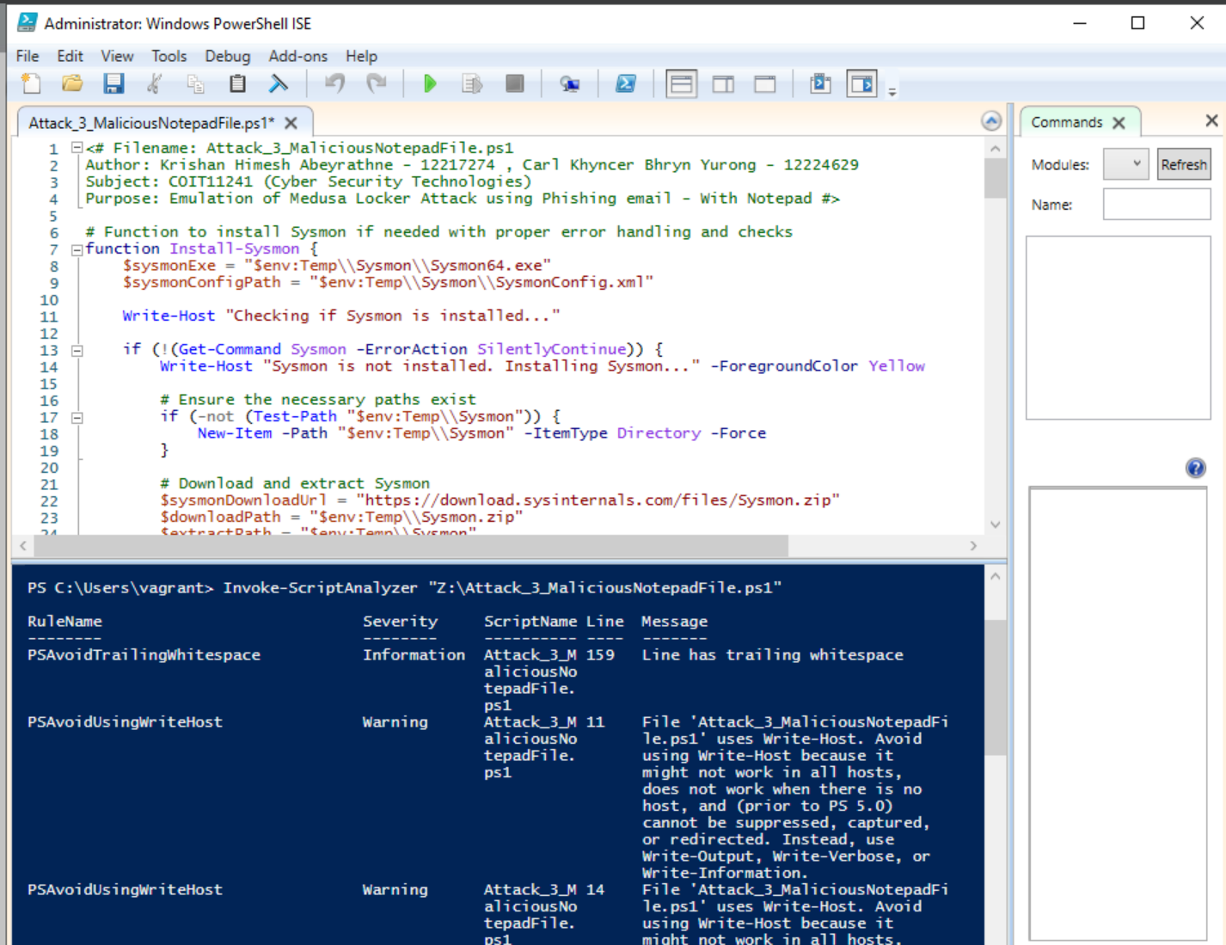
Analyze the script-3 using the script analyzer and clean the script - Before

Slide 51
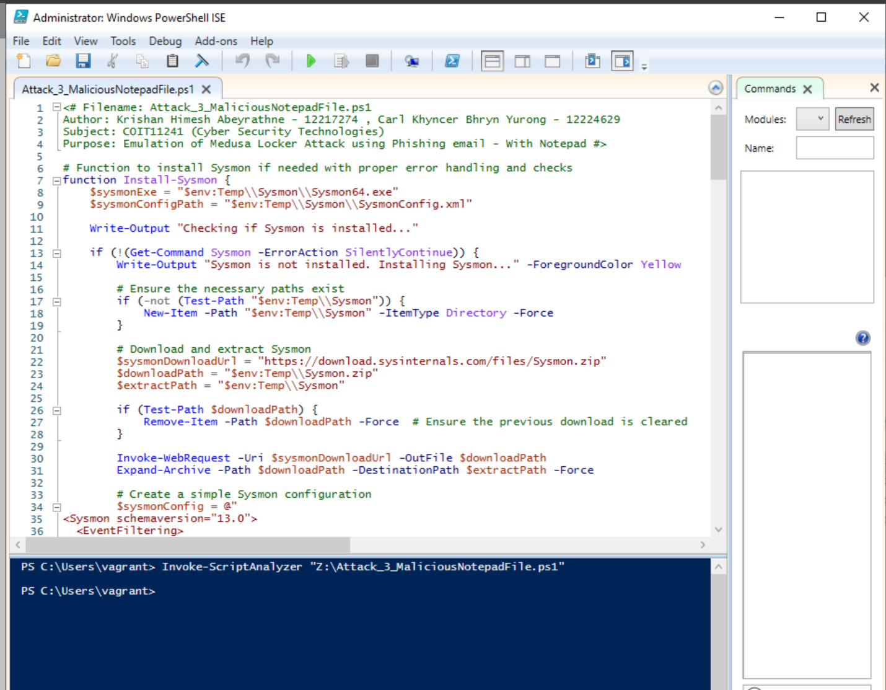
Analyze the script-3 using the script analyzer and clean the script - After
This Screenshot shows after cleaning the script using Script Analyzer. There are no warnings after invoking the script analyzer.

Slide 52
CONCLUSION: In conclusion, our vulnerability assessment utilized tools like Nessus to search for vulnerabilities across all nodes in our information system. Based on our findings, we prioritized vulnerabilities by their likelihood of exploitation by threat actors, selecting the three CVEs most susceptible to exploitation. Our analysis incorporated CAPECs and CWEs to rationalize our choices. Additionally, we traced each CVE to related ATT&CK codes, considering whether they were used by the Medusa threat actor.
Additionally, we created two attacks using PowerShell on Win2022, making sure they accurately mimicked the behavior of the threat actor's malware. This comprehensive approach allows us to not only identify vulnerabilities but also prioritize them effectively, enhancing our organization's security posture and readiness to defend against potential threats.

Slide 53
REFERENCES:
CertNZ 2024, How ransomware happens and how to stop it, Viewed 24 April 2024, https://www.cert.govt.nz/it-specialists/guides/how-ransomware-happens-and-how-to-stop-it/
ChatGPT 3.5. 2024, ChatGPT. OpenAI. https://chat.openai.com/
Cybersecurity and Infrastructure Security Agency (CISA) 2024, Alert (AA22-181A) - Tactics, Techniques, and Procedures of Conti Ransomware, Viewed: 24 April 2024 https://www.cisa.gov/news-events/cybersecurity-advisories/aa22-181a
Cybersecurity and Infrastructure Security Agency (CISA) 2024, #StopRansomware: Medusa Locker, Viewed: 24 April 2024 https://www.cisa.gov/news-events/cybersecurity-advisories/stopransomware-medusalocker
Forum of Incident Response and Security Teams (FIRST) 2024, CVSS v4.0 Calculator, Viewed: 24 April 2024 https://www.first.org/cvss/calculator/4.0
HHS 2023, HC3: Analyst Note, Viewed 24 April 2024, https://www.hhs.gov/sites/default/files/medusalocker-ransomware-analyst-note.pdf
Mitre Corporation 2024, CVE-2016-2183. Common Vulnerabilities and Exposures, Viewed: 24 April 2024 https://cve.mitre.org/cgi-bin/cvename.cgi?name=CVE-2016-2183

Slide 54
REFERENCES:
Mitre Corporation 2024, CWE-451: User of Shared Resource Without Proper Synchronization ('Race Condition'). Common Weakness Enumeration, Viewed: 24 April 2024 https://cwe.mitre.org/data/definitions/451.html
Mitre Corporation 2024, CAPEC-1000: Abuse of Functionality. Common Attack Pattern Enumeration and Classification, Viewed: 24 April 2024 https://capec.mitre.org/data/definitions/1000.html
MITRE ATT&CK® 2024, Techniques - Enterprise, Viewed: 24 April 2024
https://attack.mitre.org/techniques/enterprise/
Palo Alto Networks. (n.d.). Medusa Ransomware Turning Your Files into Stone, Viewed: 24 April 2024
https://unit42.paloaltonetworks.com/medusa-ransomware-escalation-new-leak-site
SOCRadar® Cyber Intelligence Inc 2023, Dark Web Profile: Medusa Ransomware (MedusaLocker), Viewed: 24 April 2024
https://socradar.io/dark-web-profile-medusa-ransomware-medusalocker/

